Slide 1

<Testing>
Notes:
Just into on why we’re here today and what’s the point of having this presentation. Brifely touch the topic of presenters: SZ, OZ, IL, and KK.
In the end: passing the floot to Sviatlana.

Slide 2

Light talk author
Ivan Mazaliuk,
Senior Software Engineer

Slide 3
Why is the testing required?
Testing allows projects save time and money because bugs are cheaper and easier to fix before they go to production.

Slide 4
What is Continuous Integration (CI)
Continuous integration (CI) is the practice of automating the integration of code changes from multiple contributors into a single software project.
Source code
Build
Deploy
Tests execution
Tests execution

Slide 5
Testing types
Unit tests (verify individual unit of source code)
Integration tests (verify the compliance of the component with specified functional requirements)
E2E tests (verify that the flow behaves as expected)

Slide 6
What is unit testing
Key points:
It verifies small piece of code
It uses mocking
It executes fast
It is isolated

Slide 7
Unit testing Demo
DEMO!

Slide 8
What is integration testing
Key points:
It verifies interaction between units/modules
It can check calls to other services/databases
It is not isolated

Slide 9
What is E2E testing
Key points:
Methodology used for ensuring that applications behave as expected
It helps release teams reduce the time to market (improves CD)
It usually includes UI hence improves user experience
It should be running independently from the service deployment

Slide 10
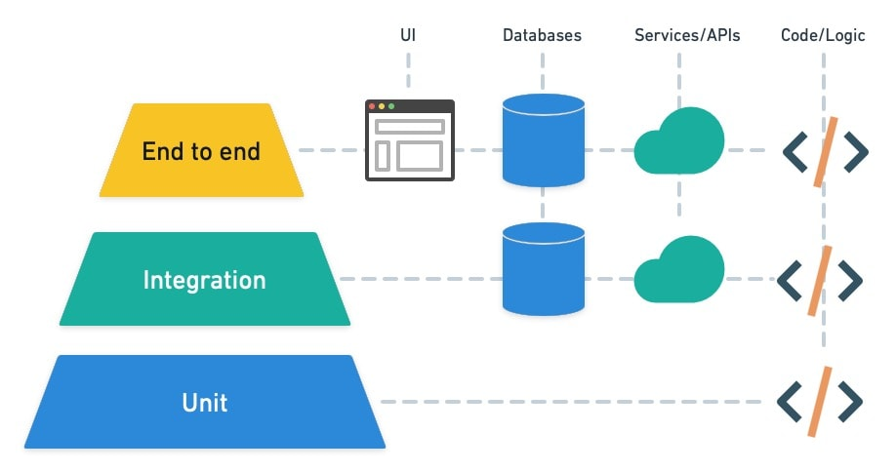
Testing pyramid

Slide 11
Tests during CI
Source code
Build
Deploy
E2E Tests execution
Unit Tests execution
Integration Tests execution

Slide 12
Types of testing
Functional testing
Unit testing
Integration testing
End-to-end testing
Non-Functional testing
Security testing
Performance testing
Stress testing
Load testing
Endurance testing
Usability testing
Compatibility testing
Scalability testing
Interoperability testing
etc.

Slide 13
QA
Do you have any questions?

